Slide 1
2018-2019 Admissions Guide for
International Applicants
Undergraduate degrees: bachelor, specialist, master
https://www.sechenov.ru/
Notes:
Этот шаблон можно использовать как начальный файл для представления учебных материалов группе слушателей.
Разделы
Для добавления разделов щелкните слайд правой кнопкой мыши. Разделы позволяют упорядочить слайды и организовать совместную работу нескольких авторов.
Заметки
Используйте раздел заметок для размещения заметок докладчика или дополнительных сведений для аудитории. Во время воспроизведения презентации эти заметки отображаются в представлении презентации.
Обращайте внимание на размер шрифта (важно обеспечить различимость при ослабленном зрении, видеосъемке и чтении с экрана)
Сочетаемые цвета
Обратите особое внимание на графики, диаграммы и надписи.
Учтите, что печать будет выполняться в черно-белом режиме или в оттенках серого. Выполните пробную печать, чтобы убедиться в сохранении разницы между цветами при печати в черно-белом режиме или в оттенках серого.
Диаграммы, таблицы и графики
Не усложняйте восприятие: по возможности используйте согласованные, простые стили и цвета.
Снабдите все диаграммы и таблицы подписями.

Slide 2
5 STEPS OF SUCCESSFUL ADMISSION
1. Choose your undergraduate degree program
2. Full fil the selection criteria
3. Submit required documents
4. Pass entry examinations
5. Start your studies
Notes:
Дайте краткий обзор презентации. Опишите главную суть презентации и обоснуйте ее важность.
Представьте каждую из основных тем.
Чтобы предоставить слушателям ориентир, можно можете повторять этот обзорный слайд в ходе презентации, выделяя тему, которая будет обсуждаться далее.

Slide 3


Undergraduate specialist programs
(Programs “General medicine”, “Dentistry” and “Pharmacy” are provided in Russian and in English)
Code | Specialist program | Qualification | Years | Form
31.05.01 | General Medicine | Medical Doctor | 6 | full-time
31.05.03 | Dentistry | Dentist | 5 | full-time
33.05.01 | Pharmacy | Pharmaceutical chemist | 5 | full-time
31.05.02 | Pediatrics | Pediatrician | 6 | full-time
32.05.01 | Preventive Medicine | Doctor for general hygiene and epidemiology | 6 | full-time
30.05.01 | Medical biochemistry | Biochemist | 6 | full-time
30.05.02 | Medical biophysics | Biophysics specialist | 6 | full-time
06.05.01 | Bioengineering & bioinformatics | Bioengineer and bioinformatics specialist | 6 | full-time

Slide 4
Undergraduate master programs
(Programs “Public Health”, “Management”, “Linguistics” are provided in Russian and in English)
Code | Bachelor program | Qualification | Years | Form
32.04.01 | Public Health | Master | 2 | full-time
38.04.01 | Economics | Master | 2 years 6 months | full-time
38.04.02 | Management | Master | 2 years 6 months | full-time
39.04.02 | Social work | Master | 2 years 6 months | full-time
44.04.03 | Special (defectological) education | Master | 2 years 6 months | full-time
45.04.02 | Linguistics | Master | 2 | full-time
19.04.01 | Biotechnology | Master | 2 | full-time

Slide 5
Selection criteria
Specialist or bachelor degree applicants must have complete secondary general education
Master degree applicants must have higher education of any level (bachelor or specialist)
The education and qualifications of all applicants must be confirmed by appropriate certificates, which are valid in the Russian Federation
All applicants must have an appropriate level of the Russian and/or English language to pass entry examinations (MCQ tests) and complete the course successfully

Slide 6

The first period for admission starts on the 20th June, 2018
August 27, 2018
Deadline for submission of documents required for admission, conducted by the University
August 31, 2018
Deadline for issuing the order of enrollment
Academic year will start on September 1st, 2018

Slide 7
The second period for admission starts on the 19thof October, 2018
October 25, 2018
Deadline for submission of documents required for admission, conducted by the University
October 31, 2018
Deadline for issuing the order of enrollment
* Academic year will start on November 1st, 2018

Slide 8
Important!
Application should be submitted personally to the University Admission Committee in Moscow
All the documents issued in a foreign country should be legalized prior to submission in accordance with the law of the Russian Federation: undergo consular legalization (in the Consulate of the Russian Federation in the country where the document was issued) or bear an Apostille stamp (for documents issued in the countries that are parties to the Hague Convention). Original documents rather than their copies should be legalized!

Slide 9
Upon arrival to the University, the applicant needs to submit the following documents to the Admission Committee:
Identity document with confirmation of citizenship and its notarized translation into Russian
Original (or a copy) of the educational certificate to be recognized in the Russian Federation at a level not lower than general secondary education with its notarized translation into Russian
6 photos (3 cm x 4 cm, matte)
Original (or a copy) of the medical certificate obtained in the Russian Federation
Notes:
Используйте заголовки разделов для каждой из тем, чтобы переход был понятен для аудитории.

Slide 10

Important!
The Russian Federation recognizes overseas degrees and (or) qualifications subject to international agreements on mutual recognition, as well as documents issued by foreign educational institutions, the list of which is set by the Government of the Russian Federation (with indication of equivalence of obtained degree and (or) qualification to degrees and (or) qualifications obtained in the Russian Federation).
Otherwise, a certificate of recognition of overseas education is required. Please, refer to http://www.nic.gov.ru/en
National Information Centre по вопросам признания образования и (или) квалификации, ученых степеней и званий, полученных в иностранном государстве ФГБУ "Главэкспертцентр"
Notes:
Будьте кратки. Сделайте текст как можно более кратким для использования крупного шрифта.

Slide 11
Important!
A medical certificate must contain results of the health checkup in accordance with the list of medical specialists, laboratory tests and instrumental examinations specified by the regulation of the Ministry of Health of the Russian Federation from April 12, 2011 N302n "Approval of the lists of occupational hazards and works, which require compulsory initial and subsequent health checkups and the Rules of conducting compulsory initial and subsequent health checkups for workers performing difficult work or working in hazardous conditions“.
Notes:
Будьте кратки. Сделайте текст как можно более кратким для использования крупного шрифта.

Slide 12
The University does not consider applicants’ previous performance!
Entry examinations must be passed!
Notes:
Будьте кратки. Сделайте текст как можно более кратким для использования крупного шрифта.

Slide 13
Undergraduate specialist programs entrance exams:
Code | Specialist program | List of examinations | Min. ACT score
31.05.01 | General Medicine | Chemistry | 54
 |  | Russian language | 54
31.05.03 | Dentistry | Professional test | 40
 |  | Chemistry | 54
 |  | Russian language | 54
33.05.01 | Pharmacy | Chemistry | 45
 |  | Russian language | 45
31.05.02 | Pediatrics | Chemistry | 54
 |  | Russian language | 54
32.05.01 | Preventive Medicine | Chemistry | 45
 |  | Russian language | 45
30.05.01 | Medical biochemistry | Chemistry | 54
 |  | Russian language | 54
30.05.02 | Medical biophysics | Physics | 54
 |  | Russian language | 54
06.05.01 | Bioengineering & bioinformatics | Mathematics | 40
 |  | Russian language | 50

Slide 14
Undergraduate bachelor programs entrance exams:
Code | Specialist program | List of examinations | Min. ACT score
19.03.01 | Biotechnology | Chemistry | 50
 |  | Mathematics | 40
 |  | Russian language | 50
34.03.01 | Nursing | Chemistry | 40
 |  | Russian language | 40
38.03.02 | Management | Mathematics | 40
 |  | Russian language | 40
39.03.02 | Social work | History | 40
 |  | social science | 42
 |  | Russian language | 40

Slide 15
Undergraduate master programs entrance exams:
Code | Specialist program | List of examinations | Min. ACT score
32.04.01 | Public Health | Public health and healthcare | 40
38.04.01 | Economics | Economics | 40
38.04.02 | Management | Management | 40
39.04.02 | Social work | Social work | 40
44.04.03 | Special (Defectology) | Defectology | 40
45.04.02 | Linguistics | Linguistics | 40
19.04.01 | Biotechnology | Biotechnology | 40

Slide 16
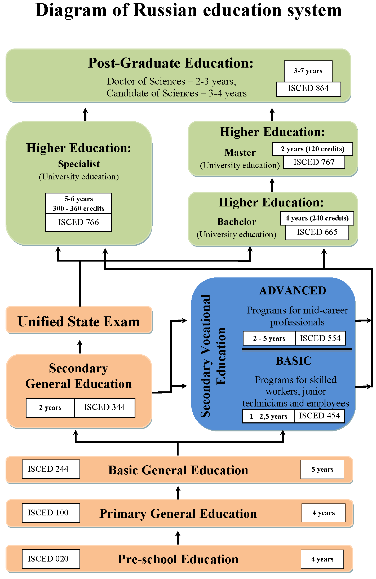
Notes:
Будьте кратки. Сделайте текст как можно более кратким для использования крупного шрифта.

Slide 17
Contact information
Monday – Friday
9-00 A.M. – 6-00 P.M.
I.M. Sechenov First Moscow State Medical University,
Center of International Education, Leading Specialist,
Julia Katrich
email: Katrich.JP@1msmu.ru
Chief of the department Ekaterina A. Popova
email: international-education@1msmu.ru
Tel. +7 (495) 609-14-00, ext. 20-58
Address: Trubetskaya Str,8, bld.2. of 126
Moscow 119991, Russia
Notes:
Используйте заголовки разделов для каждой из тем, чтобы переход был понятен для аудитории.

